Slide 1

BASIC Python for structural engineers
How to take advantage of Python in our daily work

Slide 2

Index
Introduction to python
parsing Plain TEXT files (NASTRAN F06 FILES)
working with MATRIX AND tables : Numpy and pandas
Working with excel files : Openxl
Working with NASTRAN : PyNASTRAn & ABAQUS

Slide 3
BIBLIOGRAPHY
Python Basic concepts : Learning Python 5th Edition (O’Reilly)
Pandas : Python For Data Analysis 3th Edition
PyNastran documentation website : https://pynastran-git.readthedocs.io/en/latest/

Slide 4
READ F06 Files
1. Previous Considerations
2. Built-in variables (int/float/str/tuple/list/dict):
3. Conditionals( if/elif/else):
4. Loops (for/while):
5. Functions and import libraries
6. Manipulating plain text files (open)

Slide 5
1. Previous consideratioNs
1. Previous Considerations
Why python?
Differences with other languages (typing/compilation/indentation)
How to write and execute python (IDE)?
Using Spyder as IDLE

Slide 6
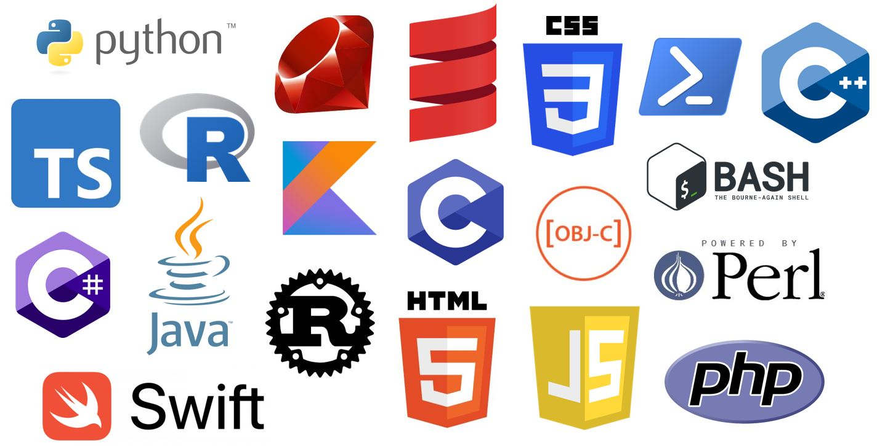
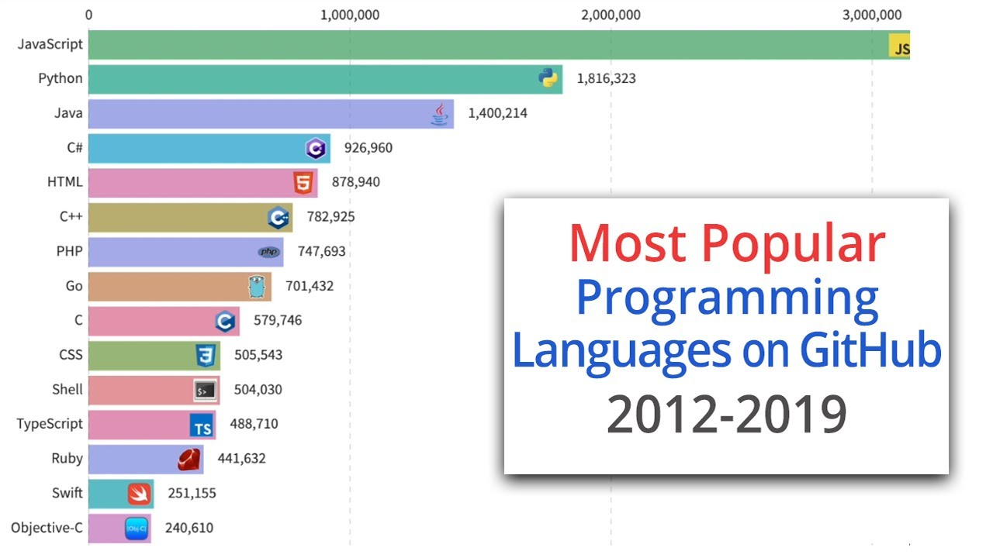
nsiderations Previous Considerationsrevious Consideration
Python was developed in the 80’s with the aim of provide a language easy to write and read. In 1991 the version 0.9.0 was released, since then, it has never stopped to evolve and get more popularity
A lot of new versions have been released since then, being the version 2.9 and 3.7 the most important ones.
Kicker box

Slide 7
Previous ConsiderationS
PROS
CONS
Easy to read/write
Dynamic typing (no need to declare variables)
Interpreted and multi-platform (no need to compile)
Free and public
Wide basic library
Could be used in for a wide range of purposes
Wide community creating every day new libraries (extremely powerful in the BigData & IA)
Everything is an object : requires more memory
No compilation : Slower than others
More memory and slower : more energy and heating problems
For some purposes, it not suitable. For example, web applications and servers.
Security. Specially if you import 3rd party libraries

Slide 8
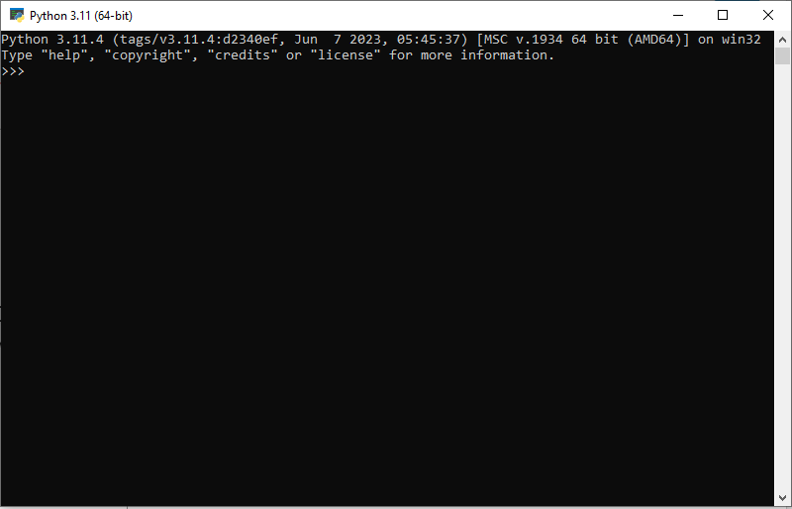
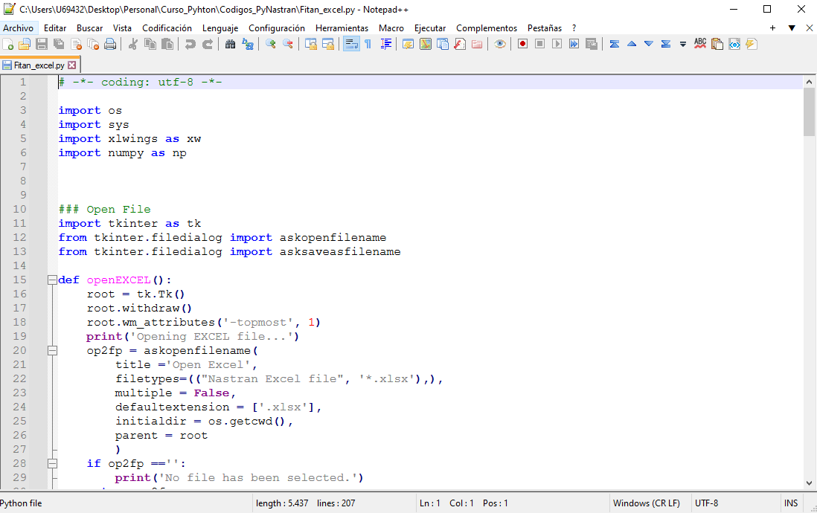
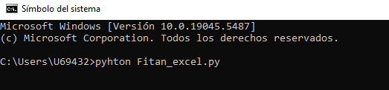
Previous ConsiderationsConsideration
How/where to write and execute python codes? (1/2)
Python uses and interpreter to read the instructions. You can downloaded it from its official website https://www.python.org/
However, you can save a serie of instructions within a text plain file with the extension *.py and execute it. Afterwards you can run within the console:
>> python <python-file>.py
Python interpreter
Code saved within a plain text file (Fitan_Excel.py)
Kicker box

Slide 9
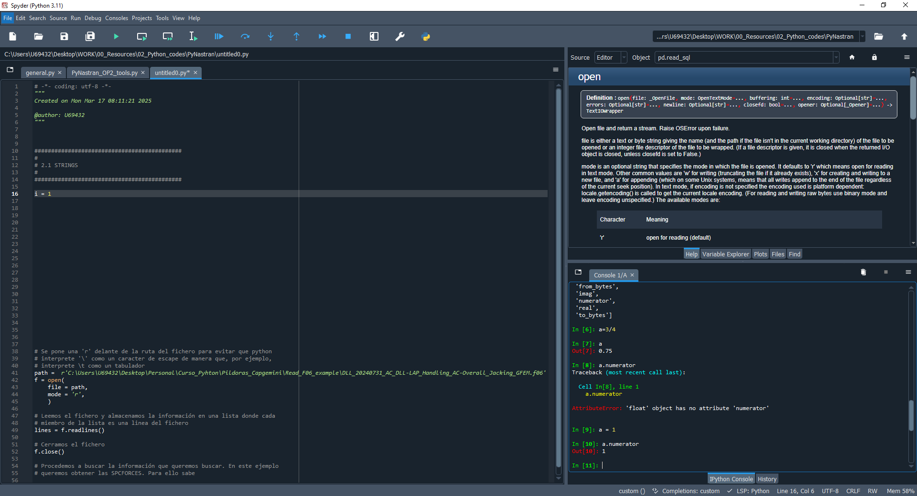
Previous Considerations
Aux window to see documentation, the variables, files, etc
How/where to write and execute python codes? (2/2)
However, writing code using programs like Notepad is not recommendable.
It is recommendable to write it using IDE (Integrated Developing Enviroment). They are software that helps you to write and depure code.
PyCharm, VisualStudio
Code
Interpreter
Kicker box

Slide 10
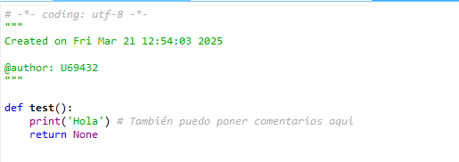
RULLING RULLING RULLING!!!
All the rules and Good Practices are described within PEP8 (https://peps.python.org/pep-0008/)
Comments : # , “””…”””
Indetation :
Always multiples of 4 spaces!!
Make the code easier to read
Kicker box

Slide 11
Everything in python is an object!ration
There is no need to declare the variable before assign it a value.
Python is capable of identifying the type of object depending on the value/data.
Actually, in Python, even the built-in variables (str, int, float) are objects which contain attributes and methods.
Example :
[1] texto = 'Javi adora los RFs de 1.0’
[2] texto.upper()
Kicker box

Slide 12
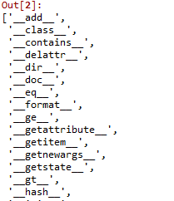
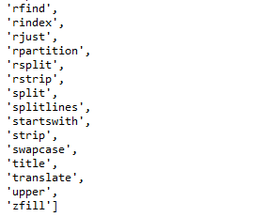
Dir function
It is highly probable that at same point, you do not know about the attributes and methods of an object.
With the function dir (obj), the problem is solved.
In Python everything is public.
However, in order to avoid problems, there is a convection which sets that if you label an attribute with underscore must be treated as “private”
Indeed, the IDE do not allow to access to this attributes and methods unless you force them
“private”
(with underscore)
[3] dir(texto)
. . .
public
Kicker box

Slide 13
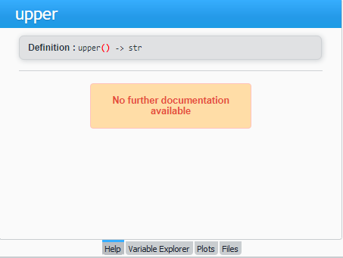
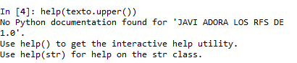
I NEED SOME HELP : GET THE DOCUMENTATION
In IDE Spyder : Pressing Ctrl+I over the object/attribute/method you want the documentation
Within the python console/interpreter
[4] help(texto.upper())
[5] print(texto.upper.__doc__)
Kicker box

Slide 14
BUILT-IN VARIABLE
2. Built-in variables
2.1 Integers (int)
2.2 Floats (float)
2.3 Strings (str)
2.4 List/Tuples (list/tuple)
2.5 Dictionaries (dict)

Slide 15
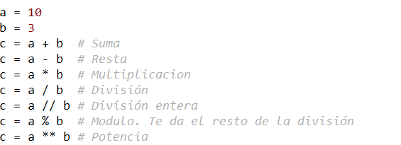
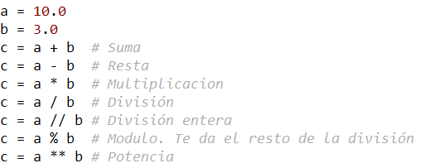

BUILT-IN VARIABLES : INT AND FLOAT
Operations with intergers
Operations with float
For versions <3.0 the operation of two intergers returns another integer
Kicker box

Slide 16
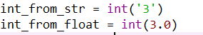
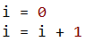
BUILT-IN VARIABLES : INT AND FLOAT
TIPS:
Conversions:
It is posible to convert str and floar variables into integers using the function int
Increments:
When using loops, it is common to use a counter to control the loop and it is typical to see the following code:
equivalent
Kicker box

Slide 17
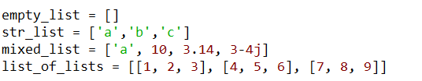
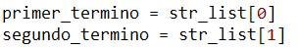
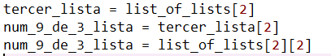
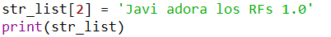
BUILT-IN VARIABLES : LIST
Defintion of list:
Features:
Indexable
Ordered
Mutable
Flexible
num_6 = list_of_lists[1][2]
Kicker box

Slide 18
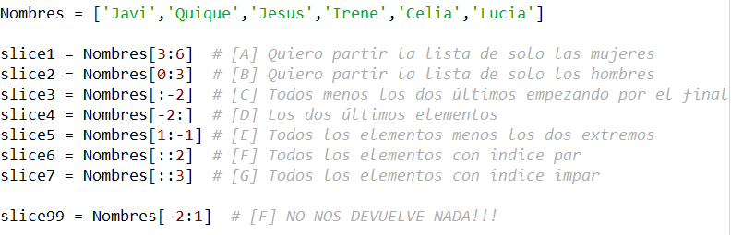
BUILT-IN VARIABLES : LIST
Slicing :
Allows to get a part of a list
Structure of the slice :
List [ index first elem : index last elem +1 : steps ]
Examples:
This scheme is also used in the For loops
Funciona sin los dos puntos tb
Kicker box

Slide 19
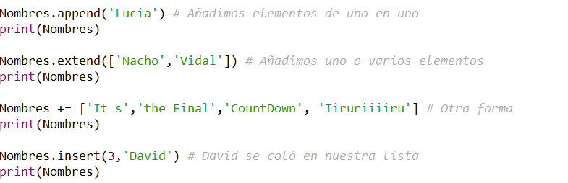
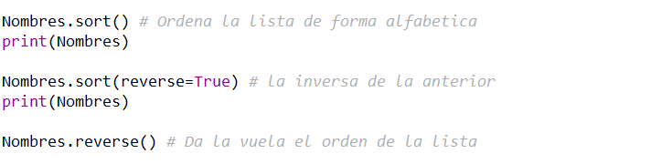
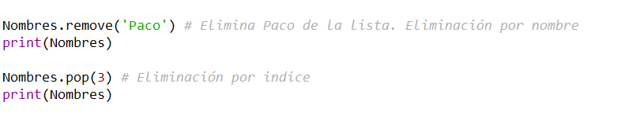
BUILT-IN VARIABLES : LIST
METHODS
ADD
ORDERING:
REMOVE
Posición donde queremos colar a David
Kicker box

Slide 20
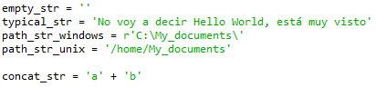
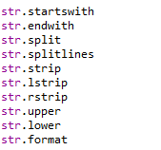
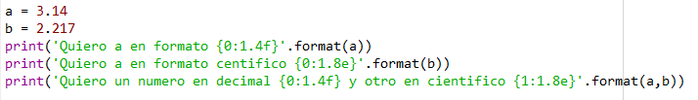
BUILT-IN VARIABLES : STR
Format():
Quite useful when writing files which has a determinated format. For instance, NASTRAN bulk cards.
Format general scheme:
“Any text {str1 } more text {str2}”.format(1.4,'Hola’)
Formating rule :
{[index]:[width].[precision][type]}
Definition :
1
Most interesting methods:
str.split
0
8
2
d
Kicker box

Slide 21
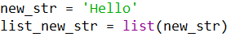
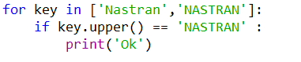
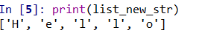
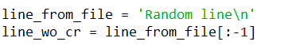
BUILT-IN VARIABLES : STR
TIPS:
Using keywords in parsing:
When parsing txt files, its quite common to use keywords. However, it is not posible to know beforehand the format of that keyword. In order to avoid it is quite useful the following code:
Strings as List:
The strings are means of sorted and indexed characters. So its easy to treat them as a list, and Python allows it.
Quite common to use this technique to remove the “Carriage Return” (Intro) of a line.
Kicker box

Slide 22
BUILT-IN VARIABLES : STR
TIPS:
Using keywords in parsing:
When parsing txt files, its quite common to use keywords. However, it is not posible to know beforehand the format of that keyword. In order to avoid it is quite useful the following code:
Strings as List:
The strings are means of sorted and indexed characters. So its easy to treat them as a list, and Python allows it.
Quite common to use this technique to remove the “Carriage Return” (Intro) of a line.
Kicker box

Slide 23
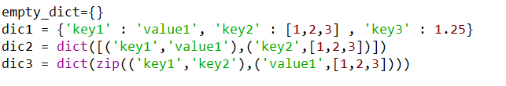
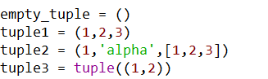
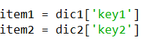
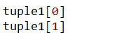
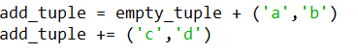
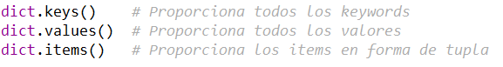
BUILT-IN VARIABLES : DICT and TUPLES
DICTIONARIES
Defintion
TUPLES
Definiton
Indexing:
Indexing:
Add/Modify:
Add/Modify:
Tuples are not mutable
Most used methods:
Most used methods:
N/A
Kicker box

Slide 24
CONDITIONALS AND LOOPS
3. Conditionals
3.1 Built-in variables: Booleans (True/False)
3.2 If/Elif/Else
4. Loops
4.1 For
4.2 While
4.3 Continue/break/next

Slide 25
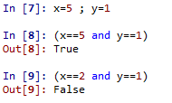
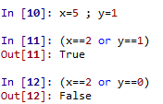
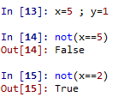
CONDITIONALS AND LOOPS: BUITL-IN BOOLEAN VARIABLE
Python uses two boolean variables: True and False.
In binary, True represents the 1 whereas the False represents 0.
Python includes all the Boolean aritemthic and logical operations
LOGICAL
LOGICAL OPERATORS
AND
Returns True (or 1) if all the conditions are met
Operation | Simbol
Greater than | >
Less tan | <
Equal to | ==
Not equal to | !=
Greater or equal to | >=
Less or equal to | <=
OR
Returns True (or 1) if at least one condition is met
NOT
Returns the True (or 1) if the condition is False and viceversa
Kicker box

Slide 26
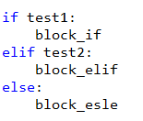
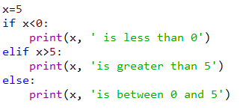
CONDITIONALS AND LOOPS: IF/ELSE/ELIF
Used to create conditions in our code.
Test1 (the result must be a boolean)
Test2 (the result must be a boolean)
You can add as much elif conditions and blocks as you need.
You can only add one else condition
It is not compulsory to add and else if it is not necessary.
Kicker box

Slide 27
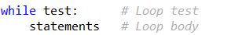
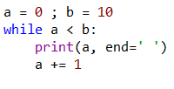
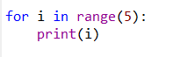
CONDITIONALS AND LOOPS: FOR AND WHILE SINTAXIS
FOR
WHILE
Use
Iterates through the elements of any sequence or iterable variable (lists, ranges, strings, tuples, etc)
Use
Executes the code within the block “while” the condition is True
General sintaxis
General sintaxis
Example
Example
item
sequence
Test (the result must be a boolean)
statetments
statetments
Kicker box

Slide 28
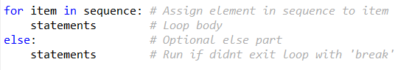
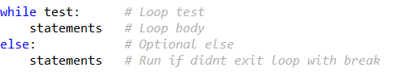
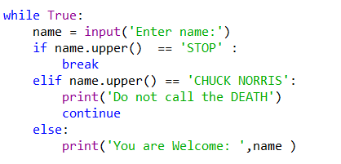
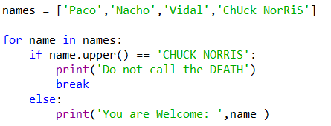
CONDITIONALS AND LOOPS: LOOP CONTROL (BREAK/CONTINUE/ELSE)
Break : Ends the loop inmediately
Continue : Continues the loop without executing the rest of the block
Else : The statements within this block is executed if the loop runs if a ‘break’ is not reached
FOR
WHILE
General sintaxis
General sintaxis
Example
Example
Kicker box

Slide 29
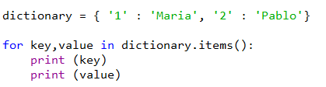
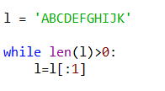


CONDITIONALS AND LOOPS: TIPS
TIPS:
Avoid the “Infinite Loop”:
It is quite common the case when using the “while” end up into a infinite loop. It is recommenable to set a counter to warn in case of a infinite loop
Key and values in dictionaries
It is posible to “unpack” dictionaries to use them in “for” loops:
Code to avoid
Infinite loop
Kicker box

Slide 30



CONDITIONALS AND LOOPS: TIPS
TIPS:
Xv[0,5]
You might be tempted (specially if you came from other languages) to write this expression like this:
Using conditionals into an assigment
If it is possible to use a conditional structure to assign the value of a variable. The code might look like this:
However you can make it simpler
Kicker box

Slide 31
FUNCTIONS AND OPERATE wITH PLAIN TEXT FILES
5. Functions
6. Operate with Plain Text Files (open function)
readlines
writelines

Slide 32


FUNCTIONS:
Core of any well structured script.
Makes the code easier and reusable
By moduling the code, it is easier to locate and isolate any bug in our code
Python assign the arguments to the functions by position if they are not specifically invonked
GENERAL SINTAXIS
EXAMPLE
compulsory arguments
optional arguments
Implictly Python does
x=1 , y=2 and z=3
Function body
Is not compulsory
Kicker box

Slide 33

SPECIAL FUNCTIONS: OPEN
Used to open or create new files
It reads/writes plain text files and also binary files
‘r’ = Reading (the file must exists)
‘w’ = writing (if the file does not exist, it creates it)
The result is a list containing all the lines of the file
Do not forget to close the file after reading it, specially if the file is going to be read again
The writelines function requires a list containing the lines of the file
Do not forget to close the file after writing it becasue Python only really writes the file when you close it. In the midtime, the lines are simply stored in the memory.
Kicker box

Slide 34
REAL EXAMPLES
FLIP THE NORMAL OF A CQUAD4 ELEMENT

Slide 35

GET THE FUTURE YOU WANT
capgemini.com

Slide 36
About Capgemini
Capgemini is a global leader in partnering with companies to transform and manage their business by harnessing the power of technology. The Group is guided everyday by its purpose of unleashing human energy through technology for an inclusive and sustainable future. It is a responsible and diverse organization of over 360,000 team members more than 50 countries. With its strong 55-year heritage and deep industry expertise, Capgemini is trusted by its clients to address the entire breadth of their business needs, from strategy and design to operations, fueled by the fast evolving and innovative world of cloud, data, AI, connectivity, software, digital engineering and platforms. The Group reported in 2022 global revenues of €22 billion.
Get The Future You Want | www.capgemini.com

